Slide 1
INTRO TO MACHINE LEARNING
BY:-
VINAYAK M R
Sethu lakshmi K P

Slide 2
WHAT IS MACHINE LEARNING?
Machine learning is the art of making sense of data !
* It does things normal code can't do and it helps to reduce the time you spend for coding.
* In machine learning we don't need to tell the algorithm what to do, we only need to show it some examples.

Slide 3
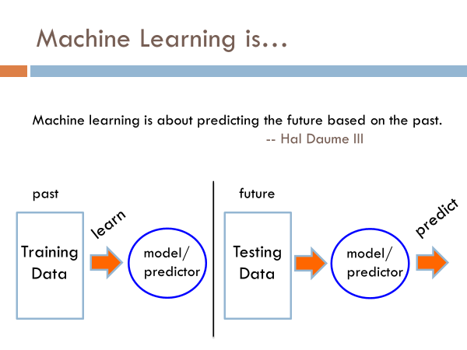

Slide 4
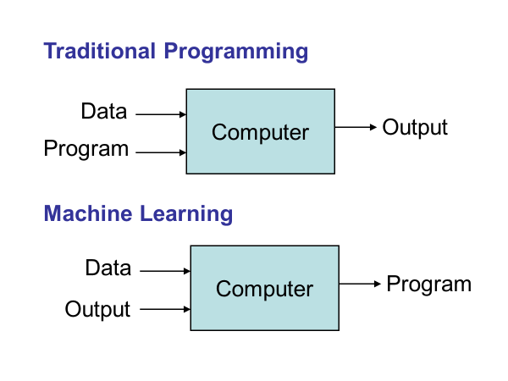

Slide 5
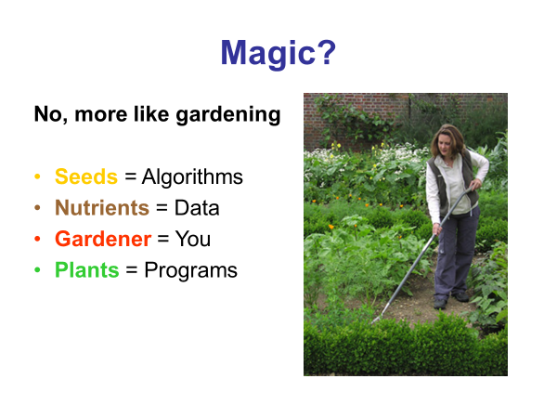

Slide 6
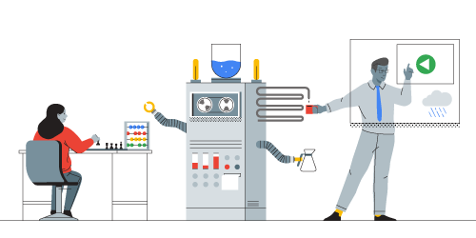
History of ML
Just fifty years ago, machine learning was still the stuff of science fiction. Today it’s an integral part of our lives, helping us do everything from finding photos to driving cars. We’ve come very far, very fast, thanks to countless philosophers, filmmakers, mathematicians, and computer scientists who fueled the dream of learning machines.

Slide 7
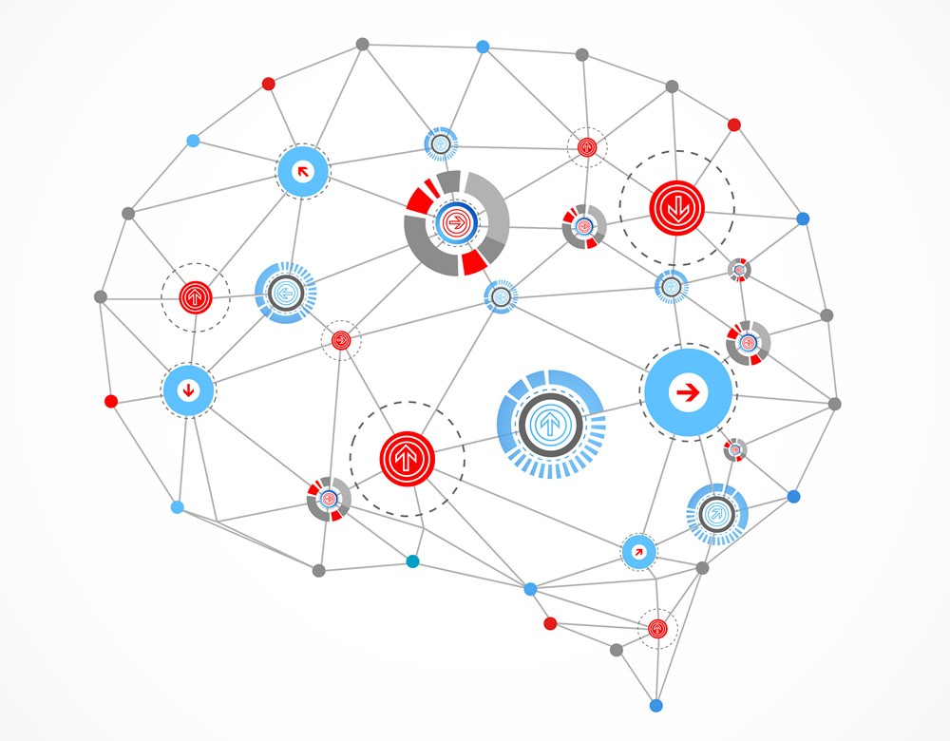
Deep Learning
Deep learning is a subset of machine learning in artificial intelligence (AI) that has networks capable of learning unsupervised from data that is unstructured or unlabeled. Also known as deep neural learning or deep neural network.
Deep learning is a subset of machine learning where artificial neural networks, algorithms inspired by the human brain, learn from large amounts of data.

Slide 8
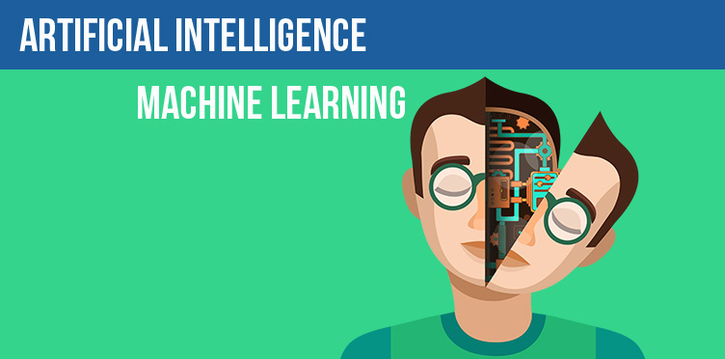
AI:
Artificial Intelligence (AI) and Machine Learning (ML) are two extremely popular and overused buzzwords at the moment; and they both are often used interchangeably. Although they aren't the same thing, popular perception believes they are the same. This piece is our attempt to explain the difference.

Slide 9
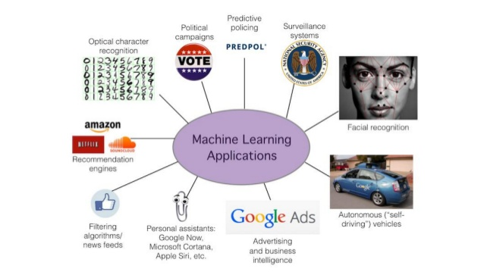
Applications:

Slide 10
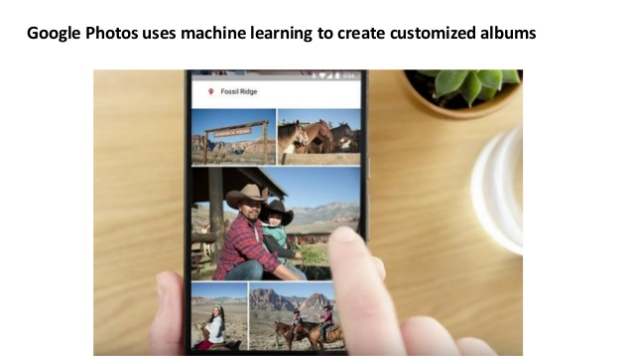

Slide 11


Slide 12
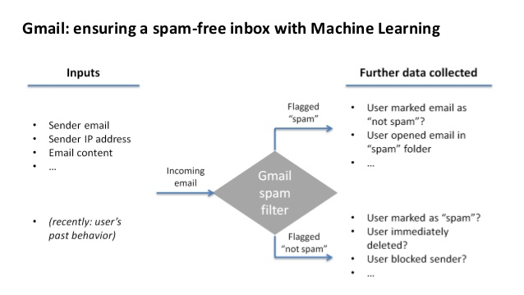

Slide 13
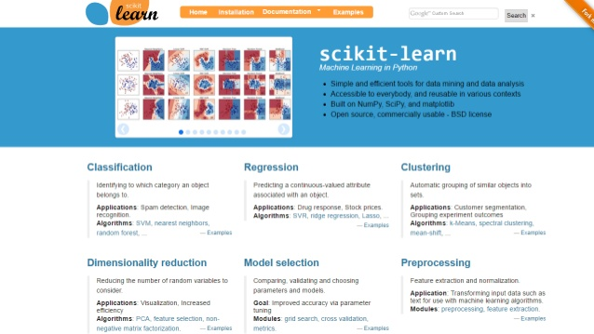
ML libraries:

Slide 14


Slide 15
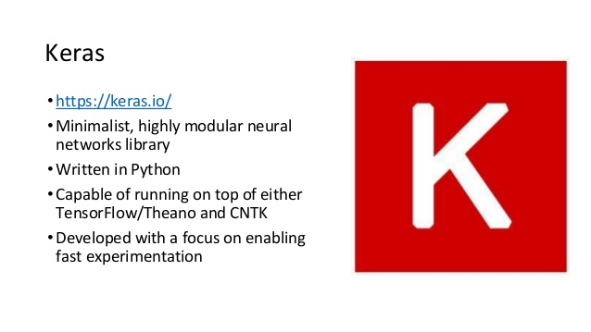

Slide 16
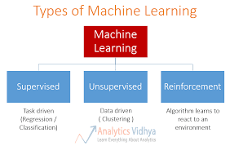
Types of Machine Learning

Slide 17
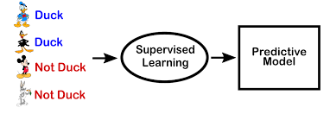
Supervised Learning

Slide 18
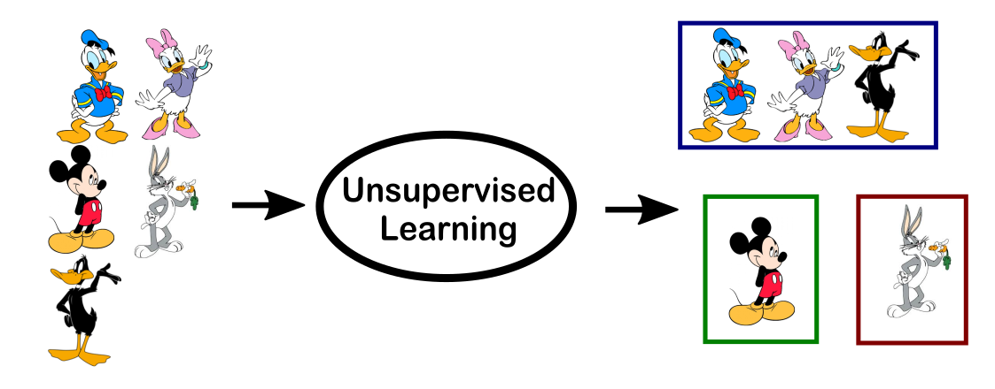
Unsupervised learning

Slide 19
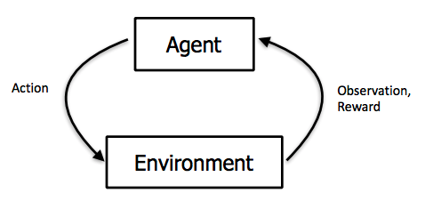
Reinforcement Learning

Slide 20
Some Terms in ML:-
Features-
A feature is an input variable—the x variable in simple linear regression
Features of house price predicting ML model can be,
* Total number of rooms.
* Age of house
* Locality of the house

Slide 21
Some terms in ML:-
Labels:
A label is the thing we're predicting. It can be the price of a product, class probability in a classification.

Slide 22
Regression Vs Classification
A regression model is used to predict continuous values.
For example,
* The probability of Tony stark coming alive in next avengers.
* Price of houses in California.
A classification model predicts discrete values. It can make predictions that answer questions like,
* Is this an image of a cat or dog or Wade Wilson.
* Predicting whether a movie belongs to DC or Marvel(based on the dark screen may be)

Slide 23
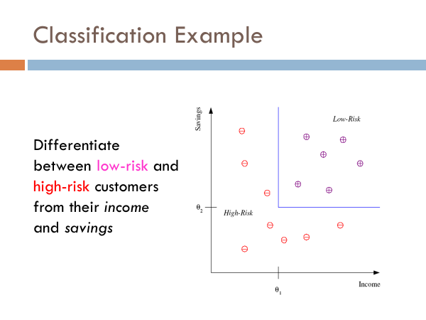
Linear classifier

Slide 24
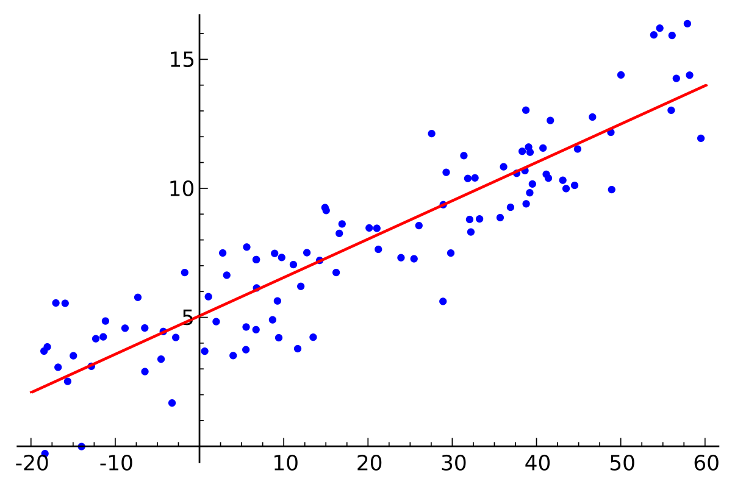
Linear Regression:
Linear regression is a method for finding the straight line or hyperplane that best fits a set of points.
The line equation is,
Y= mx+b
In machine learning we use this convention instead,
Y’= b+ w1x1
Where,
y' is the label we are predicting.
b is the bias.
w1 is the weight of feature 1.
x1 is a feature (a known input).

Slide 25

Mean square error (MSE):

Slide 26
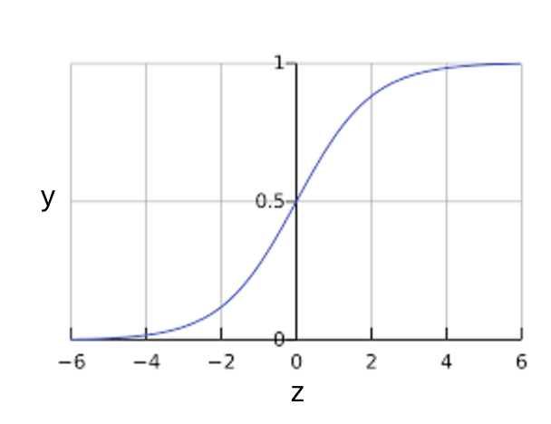
Logistic Regression
Many problems require a probability estimate as output.
Logistic regression is an extremely efficient mechanism for calculating probabilities.
For example, consider that the probability of coconut falling on someone's head while walking through a field is 0.05. Then over the year 18 accidents will happen in that field because of coconut!
P(thenga|day) = 0.05 coconut falling on head = 0.05*365 ~= 18

Slide 27
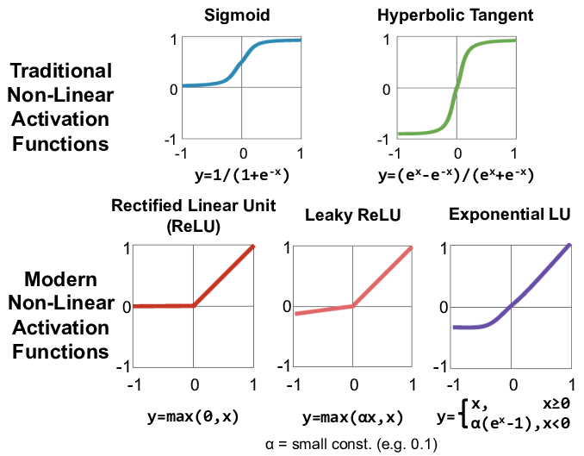
Activation Function:
Activation function decides, whether a neuron should be activated or not by calculating weighted sum and further adding bias with it. The purpose of the activation function is to introduce non-linearity into the output of a neuron.
The Activation Functions can be basically divided into 2 types-
Linear Activation Function
Non-linear Activation Functions
* Sigmoid or Logistic Activation Function
* ReLU (Rectified Linear Unit) Activation Function
* Tanh or hyperbolic tangent Activation Function

Slide 28
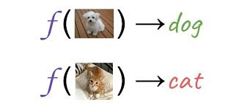
Reducing Loss
Reducing the loss is similar to the "Hot and cold game" kids play!
A Machine Learning model is trained by starting with an initial guess for the weights and bias and iteratively adjusting those guesses until learning the weights and bias with the lowest possible loss.

Slide 29
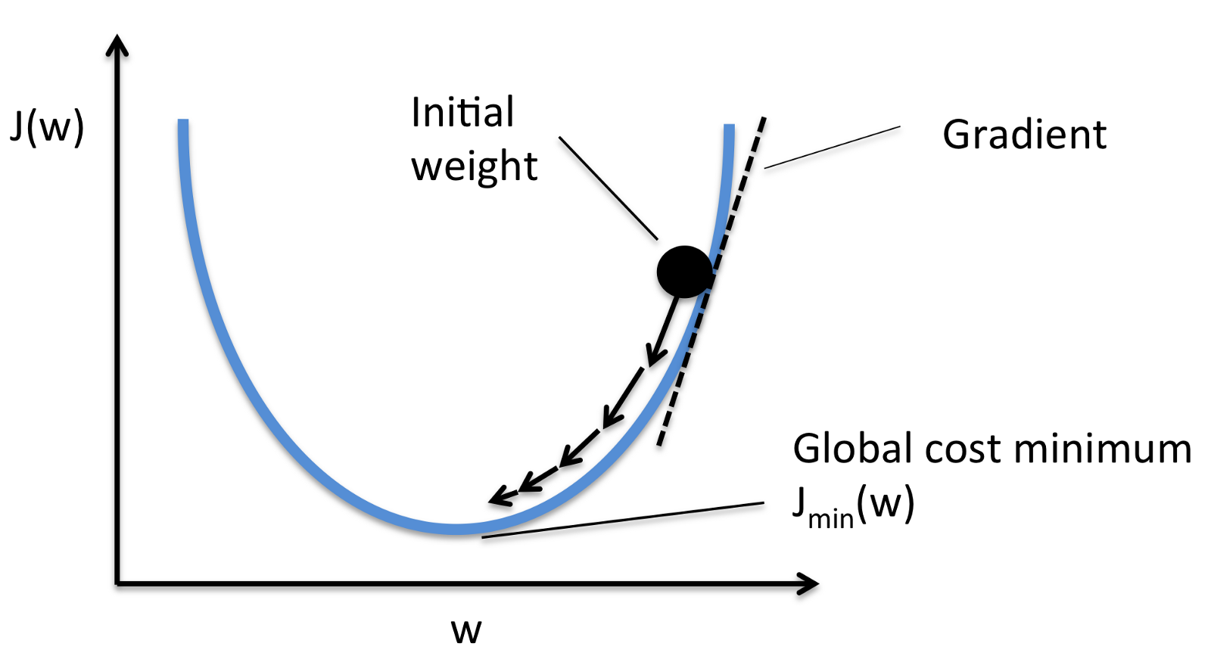
Gradient Descent

Slide 30
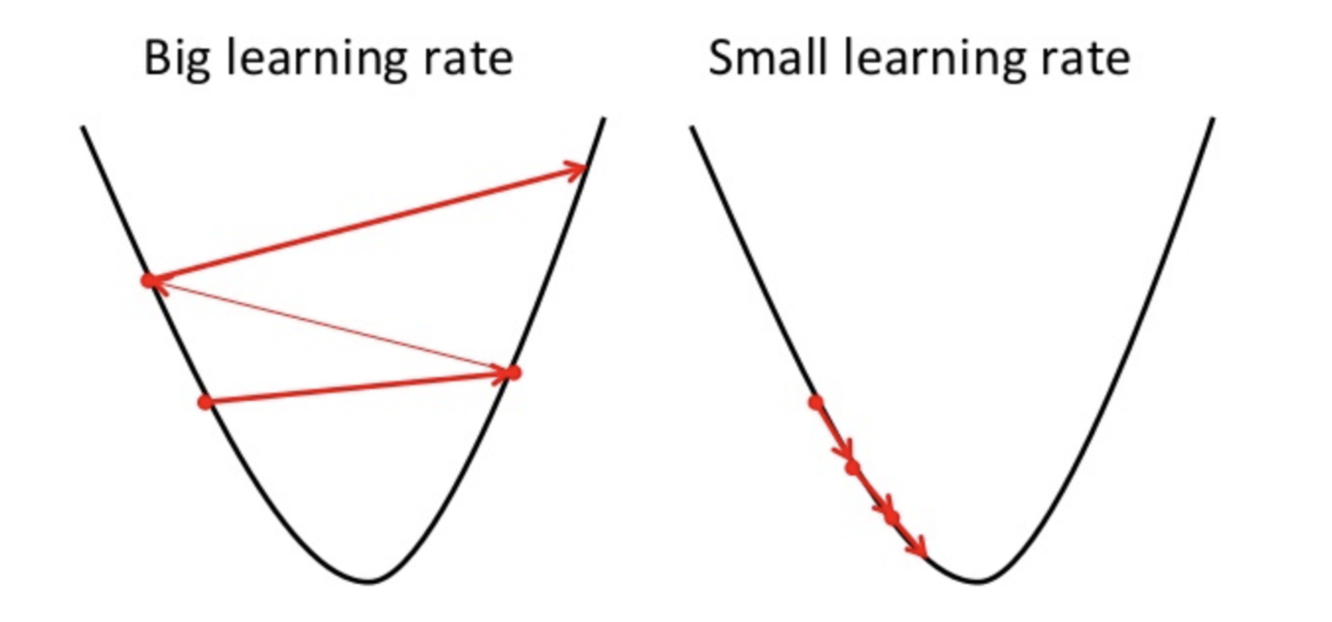
Learning Rate

Slide 31
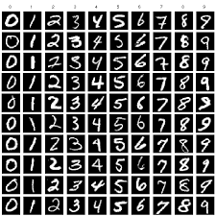
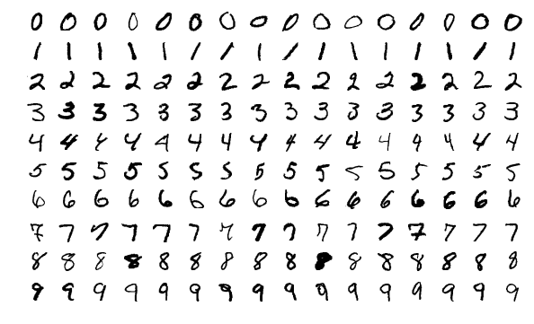
Training and Testing Sets
Our goal is to create a machine learning model that generalizes well to new data.
We train the model using a Training set and the test set act as a proxy for new data!
training set — a subset to train a model.
test set — a subset to test the trained model.

Slide 32
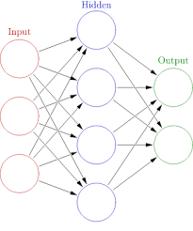
Neural Networks:
A neural network is a network or circuit of neurons, or in a modern sense, an artificial neural network, composed of artificial neurons or nodes

Slide 33
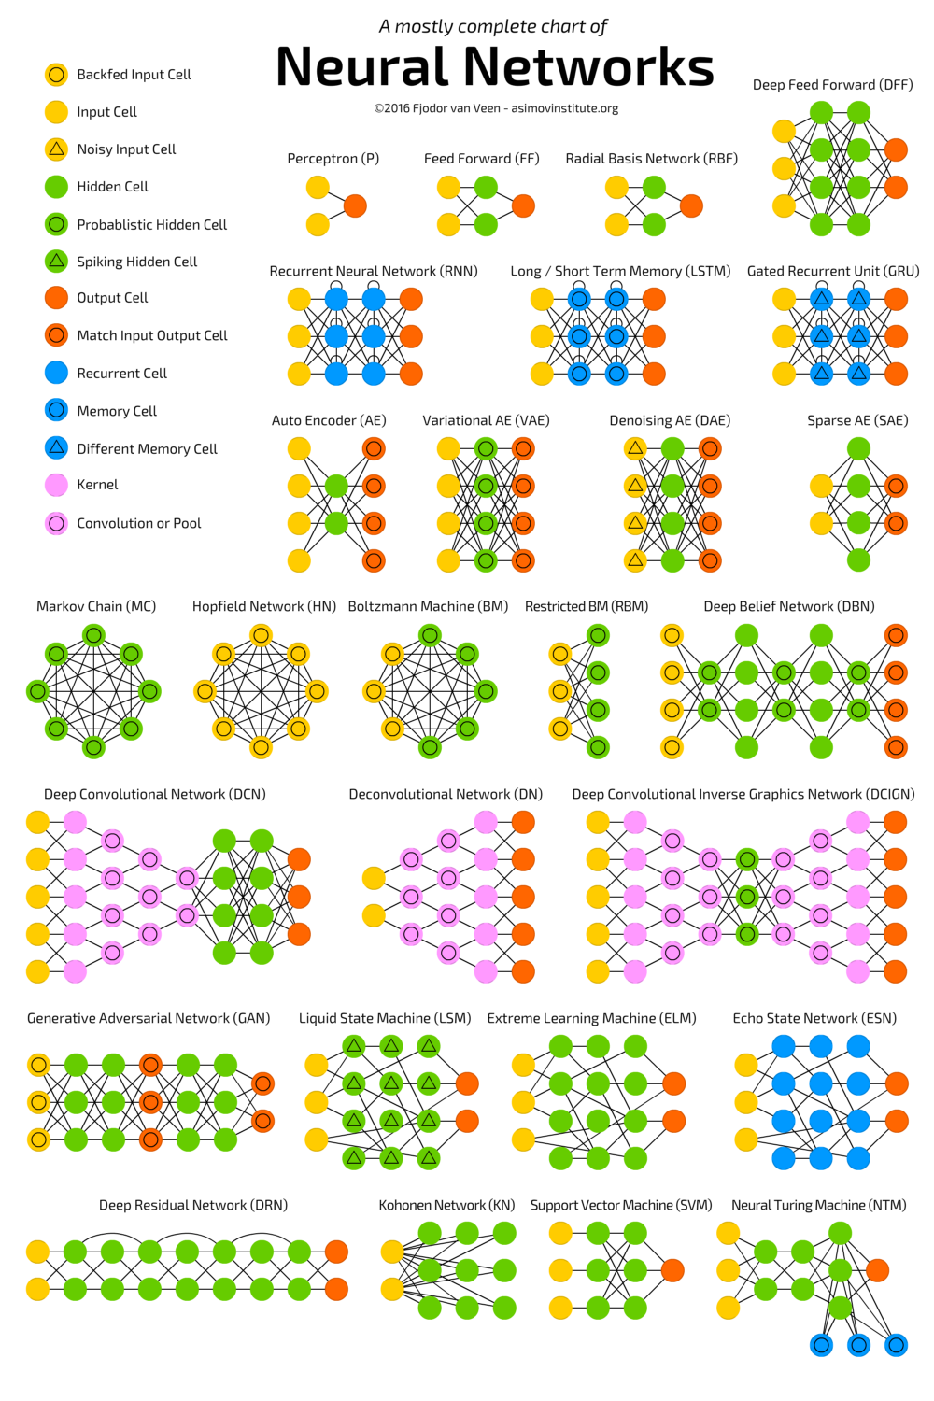
Types of neural networks

Slide 34
https://www.youtube.com/watch?v=ayPqjPekn7g
https://experiments.withgoogle.com/collection/ai
https://playground.tensorflow.org/
https://www.youtube.com/watch?v=Ur8Q-mANxUI
https://www.youtube.com/watch?v=Ur8Q-mANxUI

